Slide 1
Welcome to CONNECT!
Bondy 2017-2018

Slide 2
Agenda:
Meet Our Team
Program Overview
Tablet Information
Student Schedules
7th Grade General Meeting @ 5:30pm Cafeteria

Slide 3
7th & 8th Grade CONNECT Teams

Slide 4
Bondy CONNECT
3 Pillars of the Connect Program
Mentoring
Personalized Learning Time (PLT)
Project Time

Slide 5
Mentoring
Each Student will have a mentor teacher to meet with weekly.
Students will set learning goals with their mentor and make plans to reach those goals.
Student-driven meetings to discuss the plan for the week and reflect on the previous week.
Mentoring conversation is recorded and emailed to parents.

Slide 6
Personalized Learning Time
(PLT)
Students are working at their own pace through Focus Area content.
Focus Areas contain Playlists.
Workshops, Peer Tutoring, Small Group Instruction, Whole Group Interruptions, One on One Tutoring, etc.
So what does this look like?

Slide 7
Project Time
Intended to mimic real-world problems and work.
Students develop the higher level thinking and life skills, such as critical thinking, communication and problem solving.
Students are graded based on the Cognitive Skills Rubric.

Slide 8
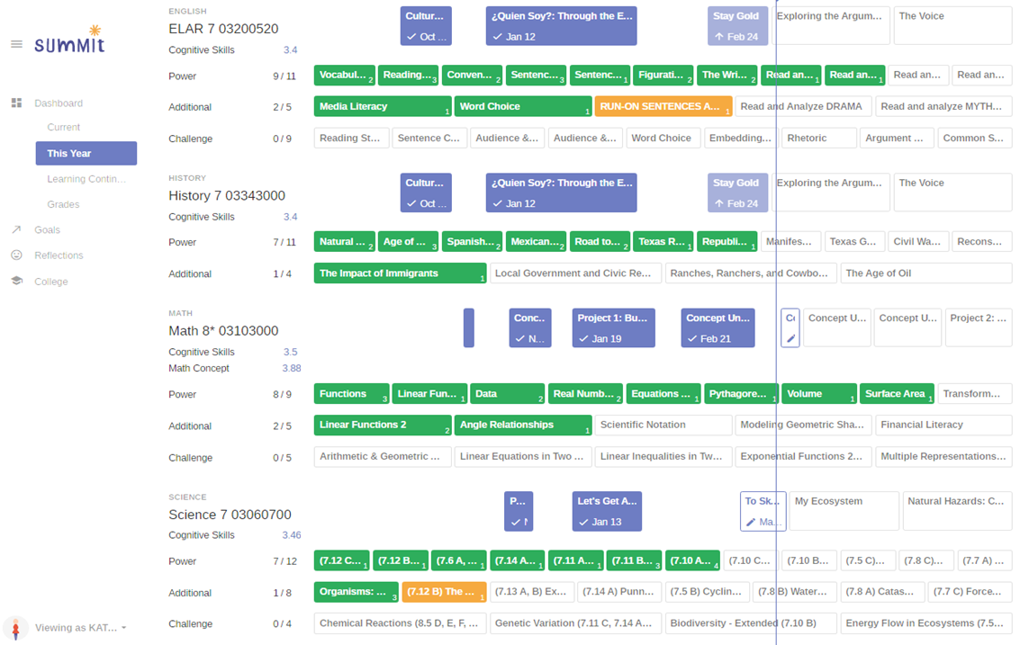
The Platform
Every student has a Personalized Learning Plan where they:
Set learning and personal growth goals.
Track progress.
Receive immediate feedback.
Able to access resources at any time 24/7.

Slide 9
CONNECT Grades
Projects 70%:
Cognitive Skills are assessed in each project.
Highest Score is Counted
Power Focus Areas 21%:
Essential Content
Mastery is Essential to Success
Students Must Pass All Power Focus Areas
Additionals 9%:
Important, but not Essential
Students get points based on percentage completed.

Slide 10
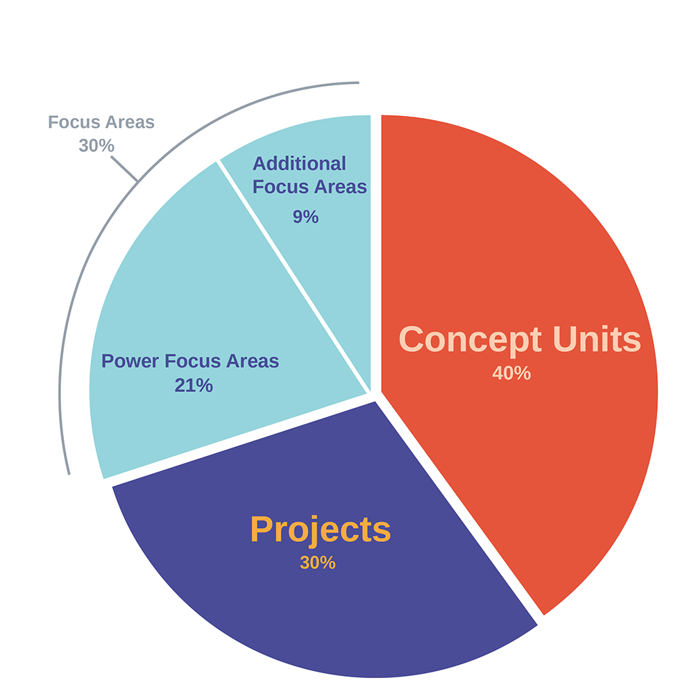
CONNECT Math
Grades
Black
Is the color of coal, ebony, and of outer space. It is the darkest color, the result of the absence of or complete absorption of light.
Concept Units 40%
Students receive grades for their demonstration of multiple math concepts in each concept unit.
Students must complete every concept unit to pass a class.

Slide 11
CONNECT Grades Cont.
Pass/Fail system is used for Progress Reports and Report Cards.
Students show Mastery with 80% or higher.
Students must meet eligibility requirements to participate in UIL events.

Slide 12
Tablet Information
$25 Fee
Tablets will be distributed to CONNECT students on Wednesday Aug. 23rd
Students must have a tablet for CONNECT.

Slide 13
Thank You!!!
Student Schedules may be picked up at the back table.
Students may walk the building and find their classrooms following the 7th Grade General Meeting in the Cafeteria.
Sign In and include your Contact Information
Contact: Mrs. Griffin, CONNECT Assistant Principal
tgriffin@pasadenaisd.org

